Slide 1
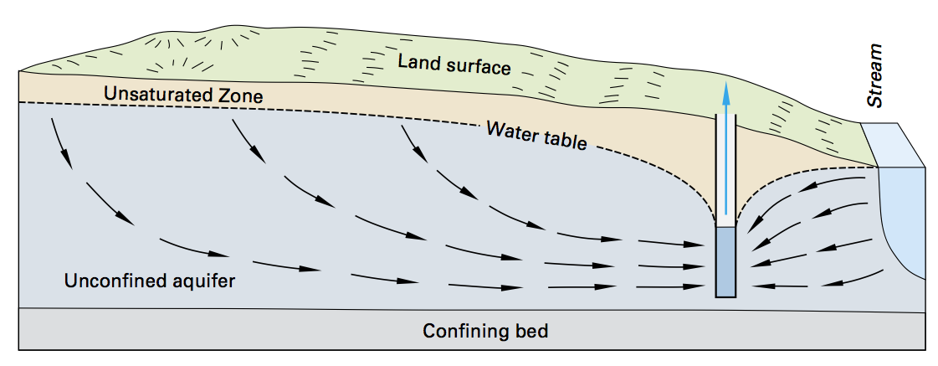
Basic Groundwater Flow
Precip/
Recharge
Pumping Well

Slide 2
Q=KA*dh/dl
Monitoring Wells
dl

Slide 3
Darcy’s Law controls groundwater flow
Q=KA*dh/dx
Q=volumetric flow (e.g. m³/s)
K=hydraulic conductivity – material’s resistance to groundwater flow
E.g. fast flow through sand, slow flow through clay
A=cross sectional area of flow
h=hydraulic head, a measure of the water’s potential energy
(units=length)
h=pressure/(density*gravity)+elevation
dh/dl=hydraulic gradient

Slide 4
Q=KA*dh/dl
Monitoring Wells
dl

Slide 5
Q=KA*dh/dl
Monitoring Wells
dl

Slide 6
Q=KA*dh/dl
Monitoring Wells
dh
dl

Slide 7
Q=KA*dh/dl
Monitoring Wells
A
dh
dl

Slide 8
Basic Groundwater Flow
Precip/
Recharge
Pumping Well

Slide 9
Computer modeling – assign boundaries
Recharge
Constant Head (stream/lake)
Inactive
Well (pumping in or out)

Slide 10
Computer modeling – simulate heads/flow
Recharge
Constant Head (stream/lake)
Inactive
Well (pumping in or out)

Slide 11
Inputs
Hydraulic conductivity (K)
Draw rectangle, assign selected cells as Gravel, Sand, Silt, or Clay
Random K field
x/y smoothing values
Constant Head
Draw rectangle around cells – assign value
Wells
Value applied to cell clicked by user
Particle Tracking
Particle dropped at user-click
Other required values
Cross-section or Map View switch)
If MapView: Unit thickness (delz)
Recharge Rate – text box and/or slider (m/s)
Number of rows/columns (nrow/ncol)
Column/row width (delc/delr)
Run Model - button

Slide 12
Layers in map view – turn on/off
Inputs
Recharge (colormap)
Wells (colormap)
or marker to overlay on other data
Recharge plus wells (colormap)
Constant head (colormap)
or marker to overlay on other data
K field (colormap)
Outputs
Head (colormap)
Head (contours)
Flow (quiver plot)
Trackline Plot (line showing direction of particle movement from origin)
Only one colormap can be turned on at a time, but markers, contours, quiver, or trackline can be turned on to overlay a colormap

Slide 13
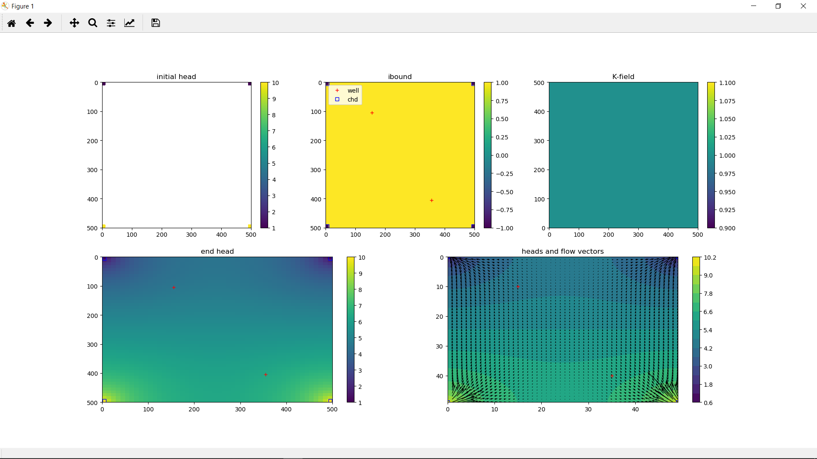

Slide 14
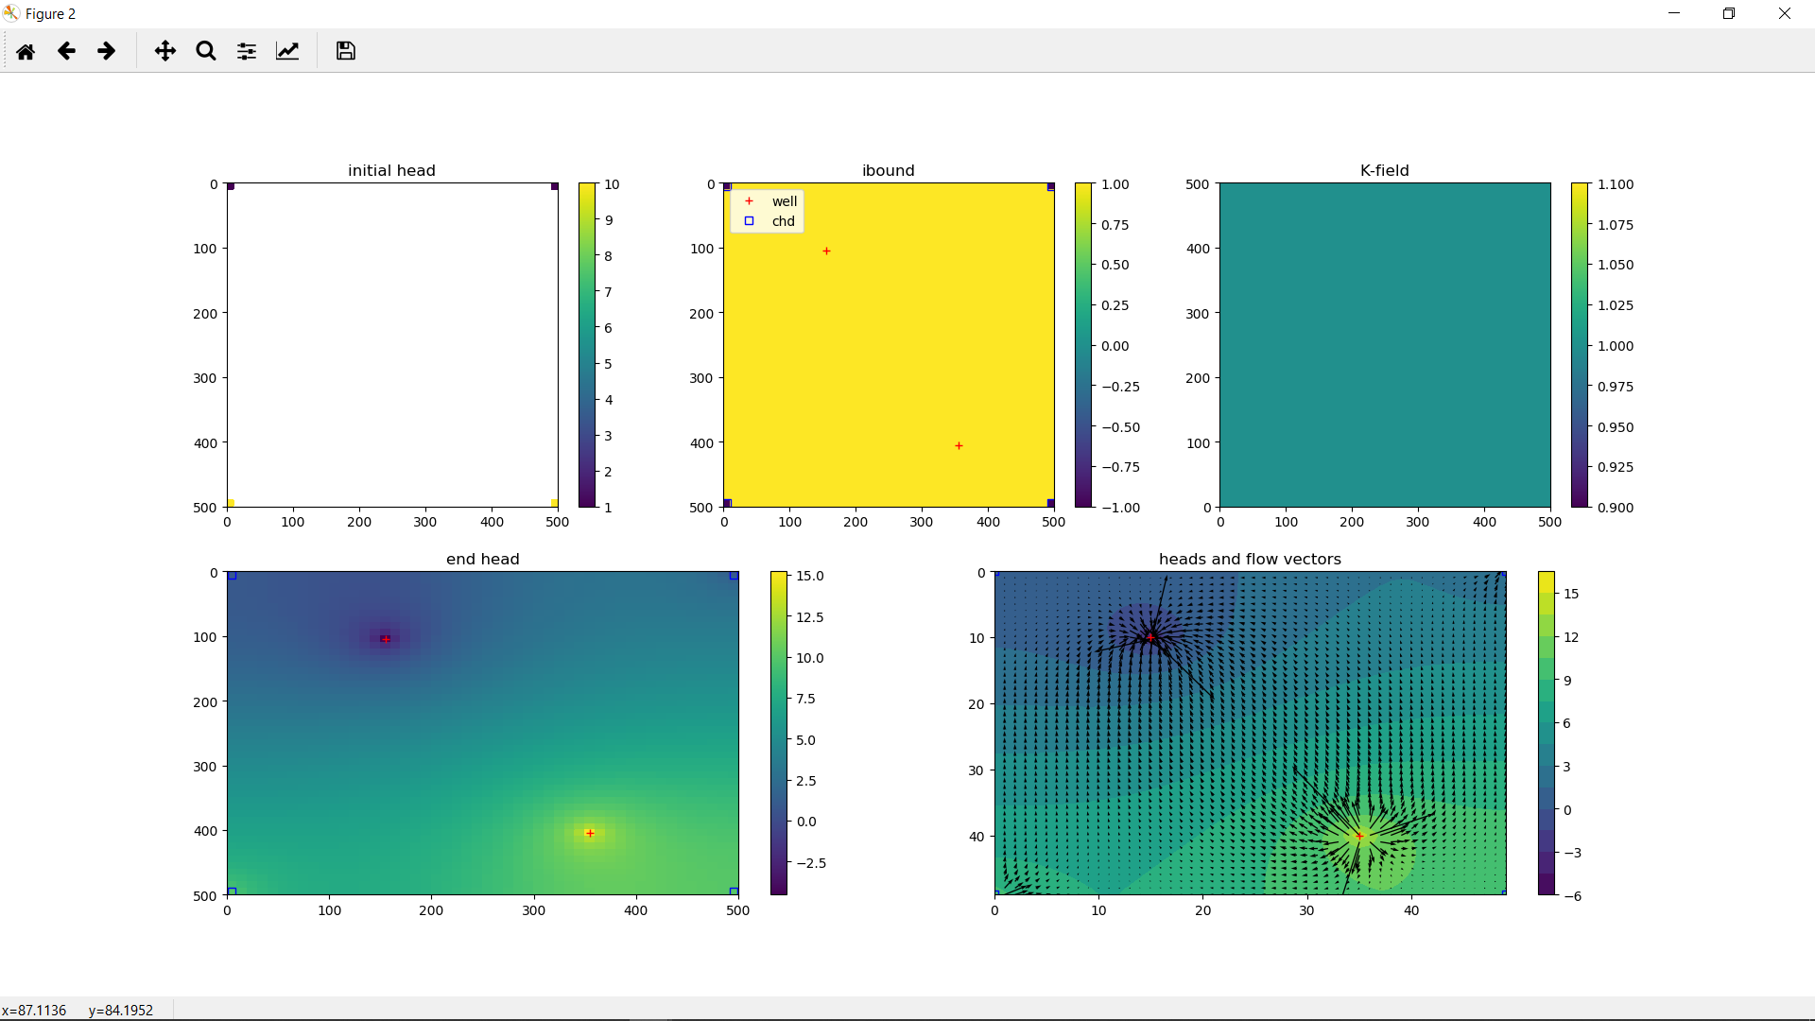

Slide 15
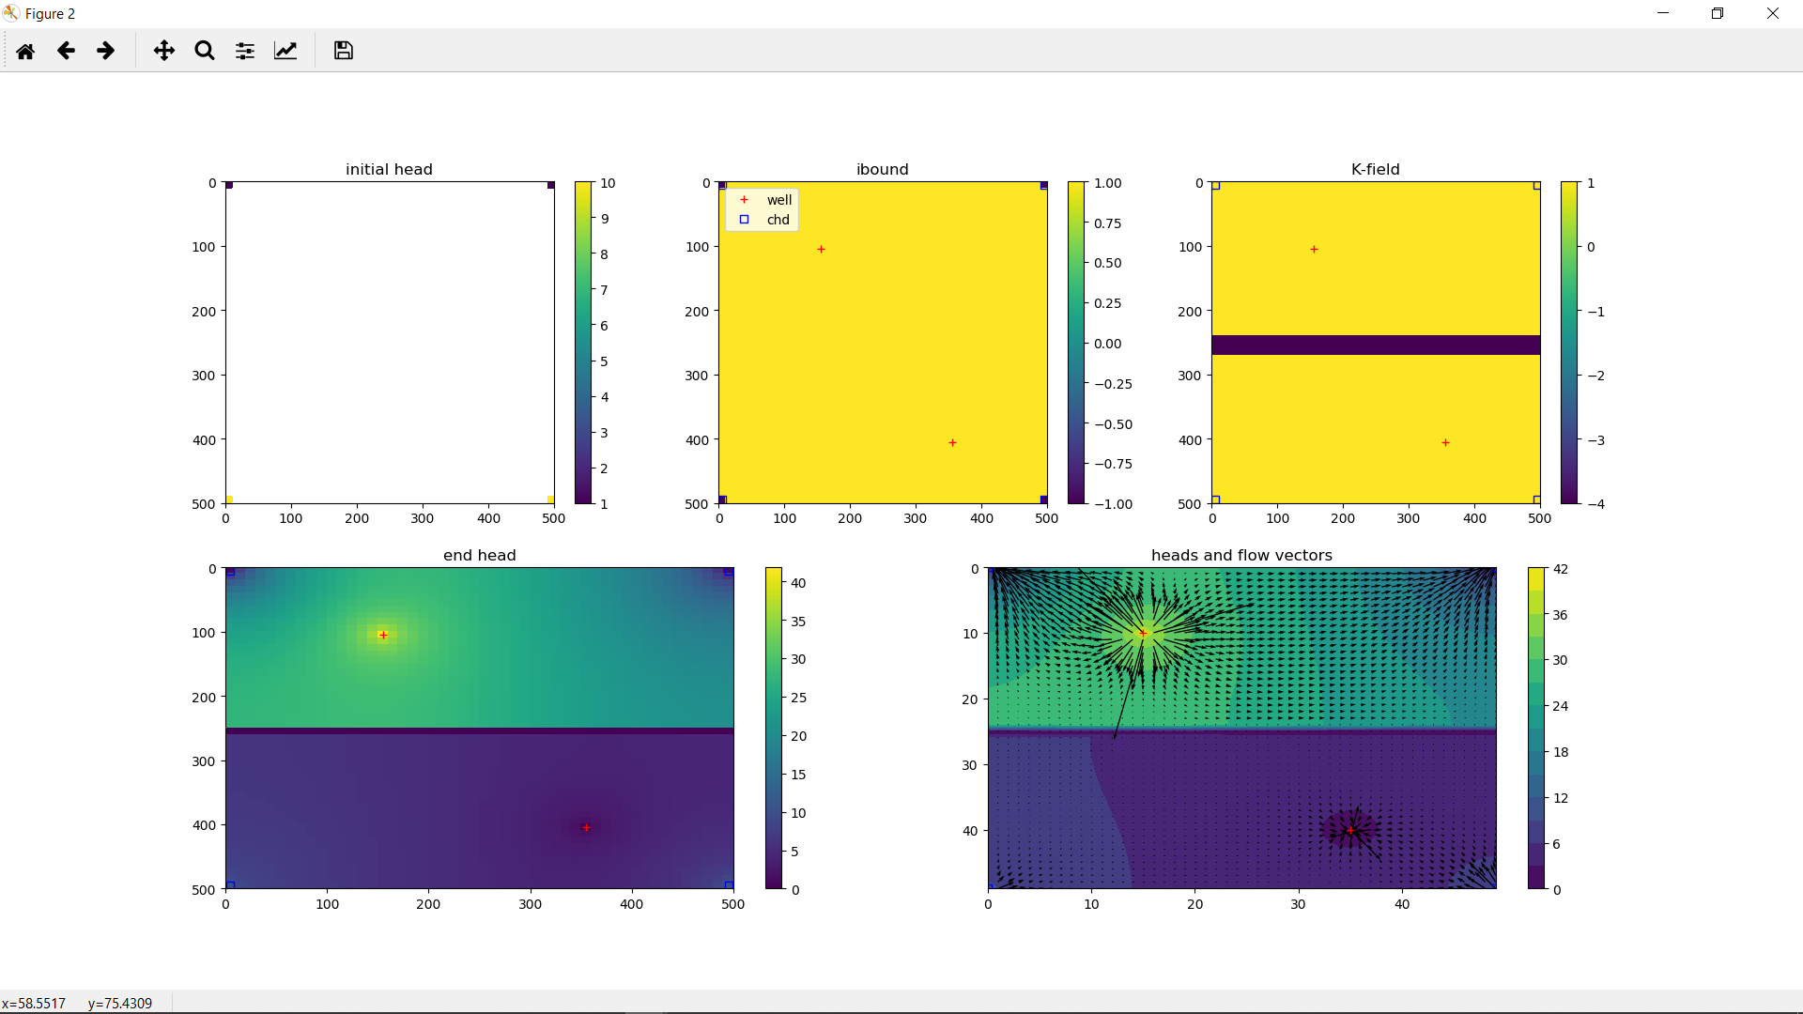

Slide 16
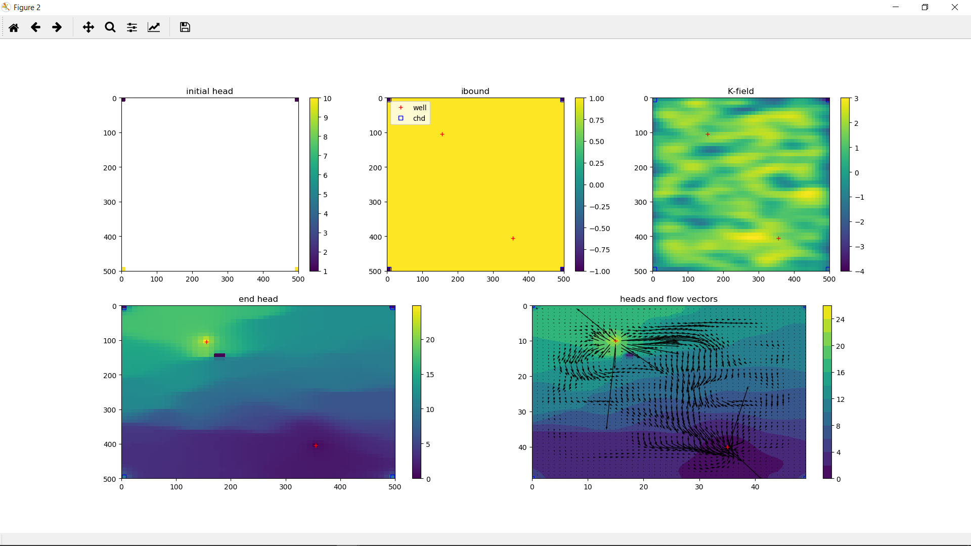

Slide 17
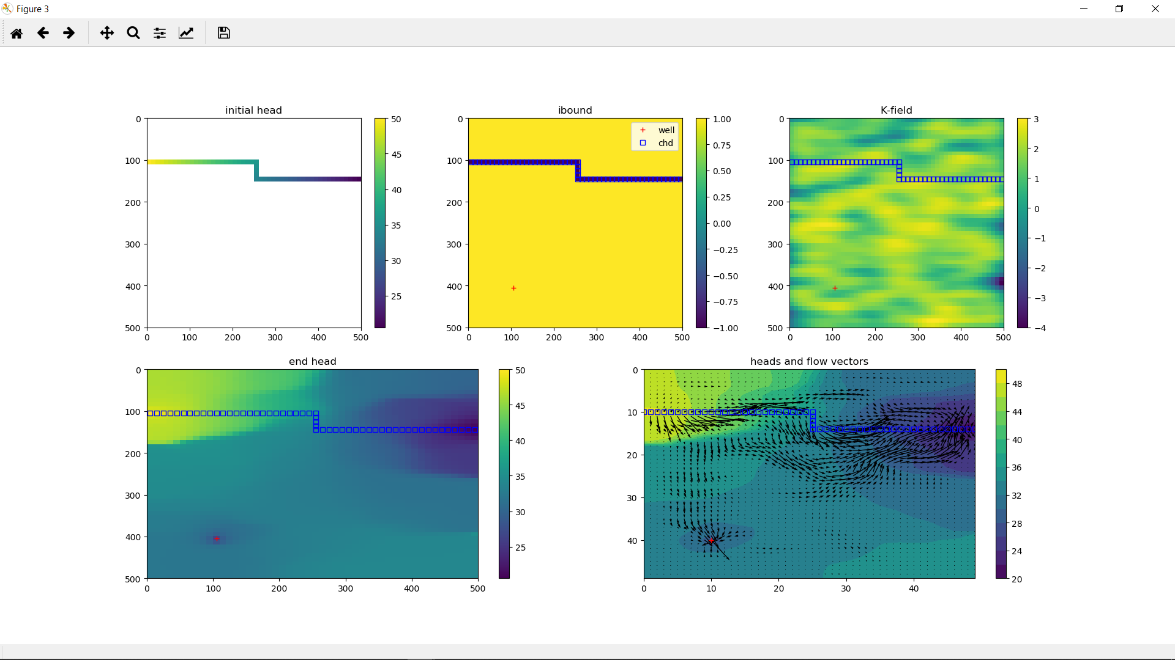

Slide 18

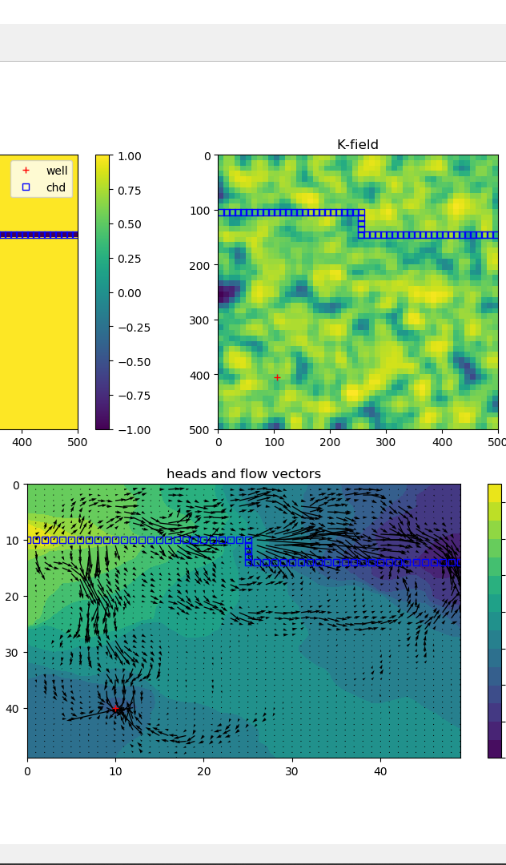
Same bounds, different random K fields
3x3
1x1
3x1

Slide 19
Particle Tracking in different models
3x3
1x1
3x1

